Slide 1
HOMOMORPHIC ENCRYPTION FOR DATA SECURITY

Slide 2
Guide
Prof. Parimal V. Tergundi
Assistant Professor
KLS Gogte Institute of Technology
Team
Akhilesh Joshi
Mangesh Wagle
Nachiket Dhamankar
Nikhil Nandavadekar

Slide 3
What is Encryption ?
Encryption is the method by which plain text or any other type of data is converted from a readable form to an encoded version that can only be decoded by another entity if they have access to a decryption key.

Slide 4
Why is it important?
Encryption allows you to securely protect data that you don’t want anyone else to have access to .
Businesses use it to protect corporate secrets, governments use it to secure classified information.
Many individuals use it to protect personal information to guard against things like identity theft.

Slide 5
Security in Cloud
Traditional standard encryption methods provide security to data in storage state and transmission state.
But in processing state, performing operations on data require decryption of data.
At this state data is available to cloud provider. Hence, traditional encryption methods are not sufficient to secure data completely.

Slide 6
Challenges
Data Confidentiality
Data Integrity
Data Availability

Slide 7
Homomorphic Encryption
Homomorphic encryptions allow complex mathematical operations to be performed on encrypted data without decrypting it intermediately.
Thus, making use of homomorphic encryption assures customers that their data is secure in all state : storage, transmission and processing.

Slide 8
Types
Fully Homomorphic Encryption (FHE) – supports arbitrary number of both additive and multiplicative operations on cipher text.
Partial Homomorphic Encryption (PHE) – support either addition or multiplication operation.

Slide 9
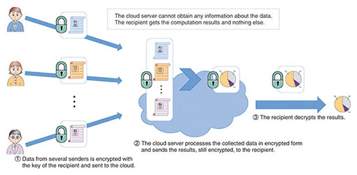
Basic Concept

Slide 10
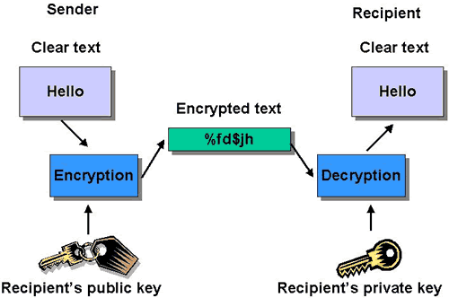
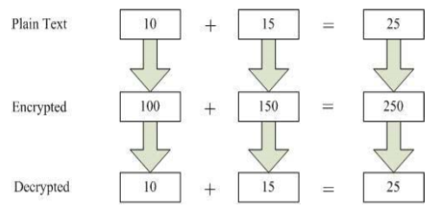
Traditional v/s Homomorphic

Slide 11
Paillier Cryptosystem
This is a partial homomorphic encryption scheme that supports
Addition of 2 Encrypted numbers.
Addition of encrypted number with a constant number
Multiplication of encrypted number with a constant number
It is a public key cryptosystem, ie, we use different keys for encryption and decryption respectively.

Slide 12
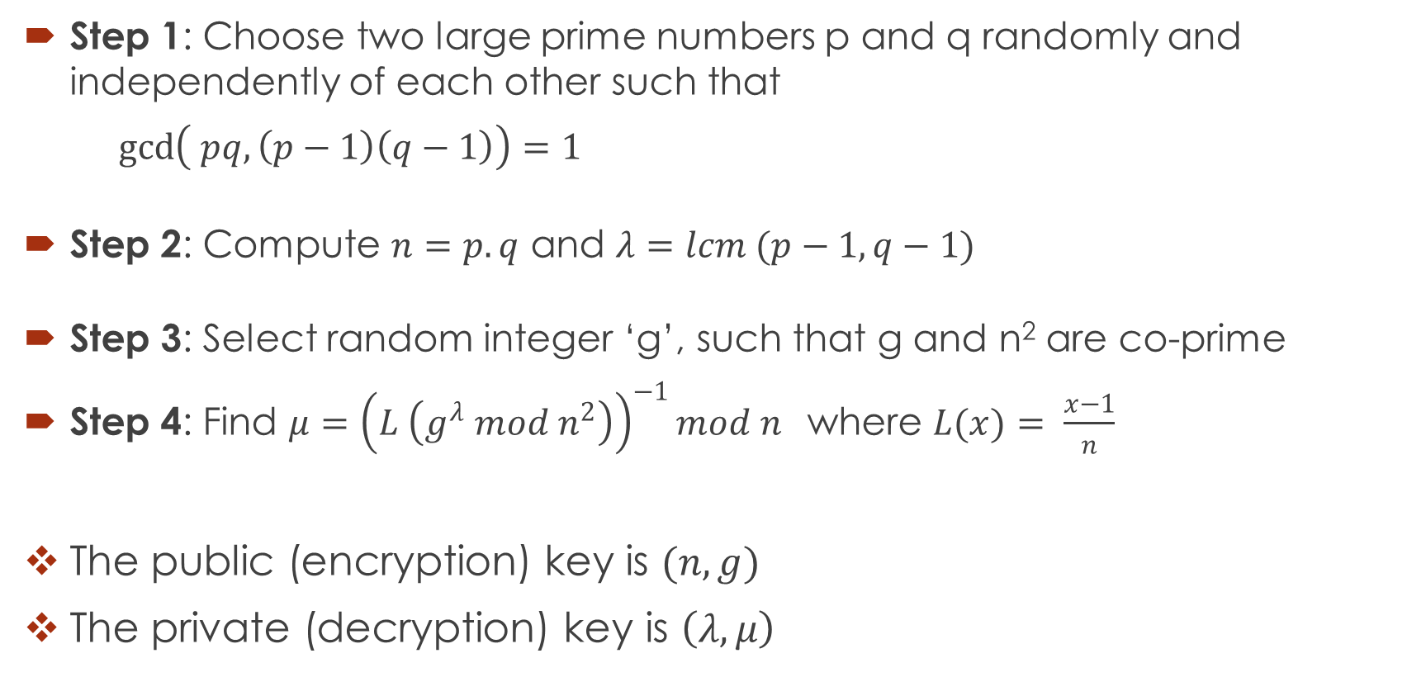
Paillier Algorithm
Step 1: Choose two large prime numbers p and q randomly and independently of each other such that
$\gcd\left( pq, \left(p−1\right)\left(q−1\right)\right)=1$
Step 2: Compute $n=p.q$ and $λ=lcm (p−1, q−1)$
Step 3: Select random integer ‘g’, such that g and n² are co-prime
Step 4: Find $μ={\left(L \left(g^{λ} mod n^{2}\right)\right)}^{−1}mod n$where $L(x)= \frac{x−1}{n}$
The public (encryption) key is $(n, g)$
The private (decryption) key is $\left(λ, μ\right)$

Slide 13
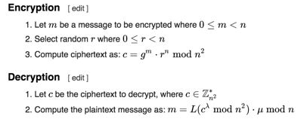

Slide 14
Paillier Homomorphic Properties
Addition of encrypted values =
d [ enc(a) * enc(b) mod n² ]
Addition of encrypted value with constant =
d[enc(a)(g^{b} mod n²) mod n²]
Multiplication of encrypted value with constant =
d[enc(a)^{b} mod n²]

Slide 15
RSA Cryptosystems
RSA Cryptosystems support only multiplication of 2 encrypted values.
RSA is a public key cryptosystem.

Slide 16
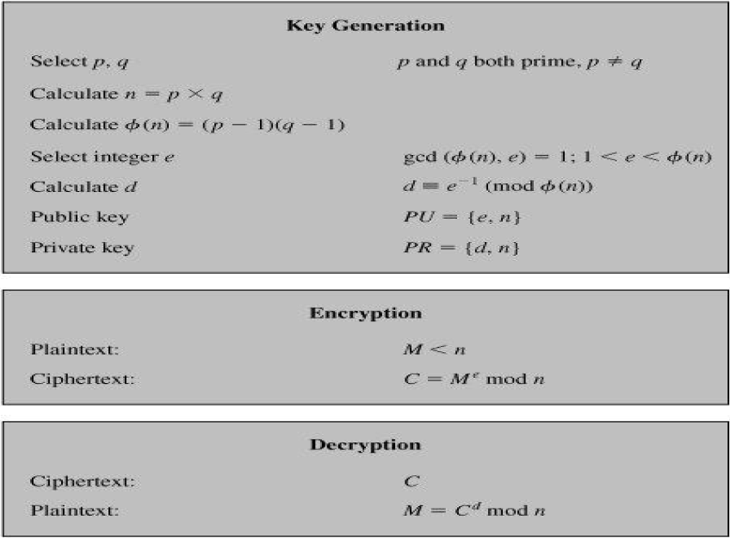
RSA Algorithm

Slide 17
RSA Homomorphic Property
Multiplication of encrypted values
d[ enc(a) * enc(b) mod n ]

Slide 18
Applications
Medical Applications
In a private cloud of medical records, data is encrypted by healthcare providers before uploading to the patients record in the cloud storage system.
This system does not provide cloud to do any computation other than search.
With HE, we can add the ability for cloud to do computation on encrypted data on behalf of the patient

Slide 19
Financial Applications
Functions which do computation on financial data may be private or proprietary, based on new predictive models and these models may be the product of costly research by financial analysts.
So, a company may want to keep these models private to preserve their advantage and their investment.

Slide 20
With HE, the customer uploads an encrypted version of the function to the cloud. The cloud service evaluates the private function by applying the encrypted description of the program to the encrypted inputs it receives.
After processing, the cloud returns the encrypted output to the customer.

Slide 21
Tools and Technologies used
Technologies
HTML5
CSS
Python
Jupyter
Apache
Bootstrap

Slide 22
Expected Results
The result of operations performed on plain text should be same as operations performed on encrypted data.
Confidentiality of data should be assured during processing of data.

Slide 23
Conclusion
Traditional encryption techniques are not sufficient to secure data in processing state.
It appears that Homomorphic encryption methods detract the problem of data security in cloud computing
But currently both fully as well as partial Homomorphic methods are not feasible and not so easy to implement for cloud computing.
Fully Homomorphic method took long time to operate on encrypted data.

Slide 24
References
[1] Kornai Kumar Chauhani, Amit K.S. Sanger, Ajai Verma – “Homomorphic Encryption for Data Security in Cloud Computing”
[2] Maha TEBAA, Said EL HAJII - “Secure Cloud Computing through Homomorphic Encryption”
[3] Mr. Manish M Potey, Dr C A Dhote, Mr Deepak H Sharma – “ Homomorphic Encryption for Security of Cloud Data”
[4] Marten van Dijk, Craig Gentry, Shai Halevi, and Vinod Vaikuntanathan – “Fully Homomorphic Encryption over the Integers”

Slide 25
Thank You

